Slide 1
Why use GPUs instead of CPUs?

Slide 2
Short Answer:

Slide 3
Short Answer:
They are faster.

Slide 4
Short Answer:
They are faster.
Way faster.

Slide 5
Short Answer:
They are faster.
Way faster.
The “fastest” and “largest” CPUs today have speeds around 4 GHs and about 128 cores, and costs about $5,000

Slide 6
Short Answer:
They are faster.
Way faster.
The “fastest” and “largest” CPUs today have speeds around 4 GHs and about 128 cores, and costs about $5,000
An “average” GPU like the RTX 3080, has core speeds of 1.5 GHs and 5,888 cores, and costs about $1,000

Slide 7
Short Answer:
They are faster.
Way faster.
The “fastest” and “largest” CPUs today have speeds around 4 GHs and about 128 cores, and costs about $5,000
An “average” GPU like the RTX 3080, has core speeds of 1.5 GHs and 5,888 cores, and costs about $1,000
Size not to scale
Cycles per second
8,832
512

Slide 8
Typical Data Science Workflows

Slide 9
Typical Data Science Workflows
Data Wrangling
Extracting raw data
Organizing/structuring data
Exploratory analysis
Cleaning messy data
Feature Engineering

Slide 10
Typical Data Science Workflows
Data Wrangling
Model training
Extracting raw data
Organizing/structuring data
Exploratory analysis
Cleaning messy data
Feature Engineering
Model selection
Model tuning
Hyperparameter optimization

Slide 11
Typical Data Science Workflows
Data Wrangling
Model training
Model validation
Extracting raw data
Organizing/structuring data
Exploratory analysis
Cleaning messy data
Feature Engineering
Model selection
Model tuning
Hyperparameter optimization
Model validation
Model testing (inference)

Slide 12
GPU Acceleration
Model training

Slide 13
GPU Acceleration
GPU acceleration is commonly concentrated in the modeling portions.
Data Wrangling
Model training
Model validation

Slide 14
GPU Acceleration
GPU acceleration is commonly concentrated in the modeling portions.
Furthermore, that concentration tends to be in the Deep Learning and Neural Networks subfields.
Data Wrangling
Model training
Model validation
Non-Deep Learning
Non-Deep Learning
Deep Learning
Deep Learning

Slide 15
GPU Acceleration
GPU acceleration is commonly concentrated in the modeling portions.
Furthermore, that concentration tends to be in the Deep Learning and Neural Networks subfields.
This isn’t necessarily a bad thing; training a model in a matter of hours or days versus weeks is a huge improvement.
Data Wrangling
Model training
Model validation
Non-Deep Learning
Non-Deep Learning
Deep Learning
Deep Learning

Slide 16
GPU Acceleration
GPU acceleration is commonly concentrated in the modeling portions.
Furthermore, that concentration tends to be in the Deep Learning and Neural Networks subfields.
This isn’t necessarily a bad thing; training a model in a matter of hours or days versus weeks is a huge improvement.
Still, it would be nice to be able to leverage the GPU for non-deep learning tasks….
Data Wrangling
Model training
Model validation
Non-Deep Learning
Non-Deep Learning
Deep Learning
Deep Learning

Slide 17
Typical CPU day
https://developer.nvidia.com/blog/gpu-accelerated-analytics-rapids/

Slide 18



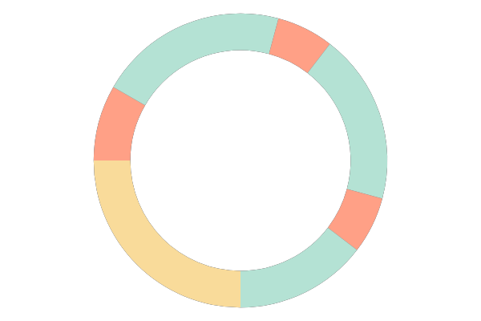
Typical CPU day
Another…
@*!# forgot to add a feature
Get a coffee
Restart ETL workflow
12
Start ETL workflow
Get a coffee
Switch to decaff
CPU POWERED WORKFLOW
Configure ETL workflow
9
3
Find unexpected null values stored as strings
dataset collection
Dataset downloads
overnight
analysis
6
ETL
train
Restart ETL workflow
inference
Stay late
https://developer.nvidia.com/blog/gpu-accelerated-analytics-rapids/

Slide 19
Points of frustration

Slide 20
Points of frustration
Model train
Model val
Data Wrangling

Slide 21
Points of frustration
Model train
Model val
Data Wrangling
~80%
~10%
~10%
At least 80% of my time was spend wrestling with the data!
Very little was left for model training and validation!
A huge bottleneck in productivity!

Slide 22
Points of frustration

Slide 23



Points of frustration
CPU 1
CPU 1
CPU 2
CPU 3
CPU 3
CPU 5
CPU 4
CPU 7
CPU 5
CPU 9
CPU 6
CPU 11

Slide 24
Points of frustration
CPU 1
CPU 1
CPU 2
CPU 3
CPU 3
CPU 5
CPU 4
CPU 7
CPU 5
CPU 9
CPU 6
CPU 11
Some languages, like R, will use all available CPU cores.
Python, by purposeful design, is limited to a single CPU.

Slide 25
Points of frustration
CPU 1
CPU 1
CPU 2
CPU 3
CPU 3
CPU 5
CPU 4
CPU 7
CPU 5
CPU 9
CPU 6
CPU 11
Some languages, like R, will use all available CPU cores.
Python, by purposeful design, is limited to a single CPU.
I can get around this by using python’s multiprocessing module, which mimics multiprocessing, but it’s still an extra step.

Slide 26





Points of frustration
CPU 1
CPU 1
CPU 2
CPU 3
CPU 3
CPU 5
CPU 4
CPU 7
CPU 5
CPU 9
CPU 6
CPU 11
Some languages, like R, will use all available CPU cores.
Python, by purposeful design, is limited to a single CPU.
I can get around this by using python’s multiprocessing module, which mimics multiprocessing, but it’s still an extra step.

Slide 27
Points of frustration
CPU 1
CPU 1
CPU 2
CPU 3
CPU 3
CPU 5
CPU 4
CPU 7
CPU 5
CPU 9
CPU 6
CPU 11
Some languages, like R, will use all available CPU cores.
Python, by purposeful design, is limited to a single CPU.
Pandas has notoriously slow read, write, and aggregation speeds
I can get around this by using python’s multiprocessing module, which mimics multiprocessing, but it’s still an extra step.

Slide 28
A wonderful unified solution

Slide 29

A wonderful unified solution

Slide 30
A wonderful unified solution
The Rapids.ai is a suite of GPU accelerated libraries for python and include:

Slide 31
A wonderful unified solution
The Rapids.ai is a suite of GPU accelerated libraries for python and include:
cuDF: mirroring Pandas
cuML: mirroring Scikit-learn
cuSignal: mirroring SciPy
cuXFilter: framework for visualization
cuGraph: mirroring NetworkX
and more!

Slide 32
A wonderful unified solution
The Rapids.ai is a suite of GPU accelerated libraries for python and include:
cuDF: mirroring Pandas
cuML: mirroring Scikit-learn
cuSignal: mirroring SciPy
cuXFilter: framework for visualization
cuGraph: mirroring NetworkX
and more!
In addition XGBoost, Dask, and Spark all have GPU implementations that utilize the Rapids engine.

Slide 33
Comparing speeds: trip data for NYC taxis
I came across these on the internet…
https://blog.cloudera.com/switching-from-cpus-to-gpus-for-nyc-taxi-fare-predictions-with-nvidia-rapids/

Slide 34
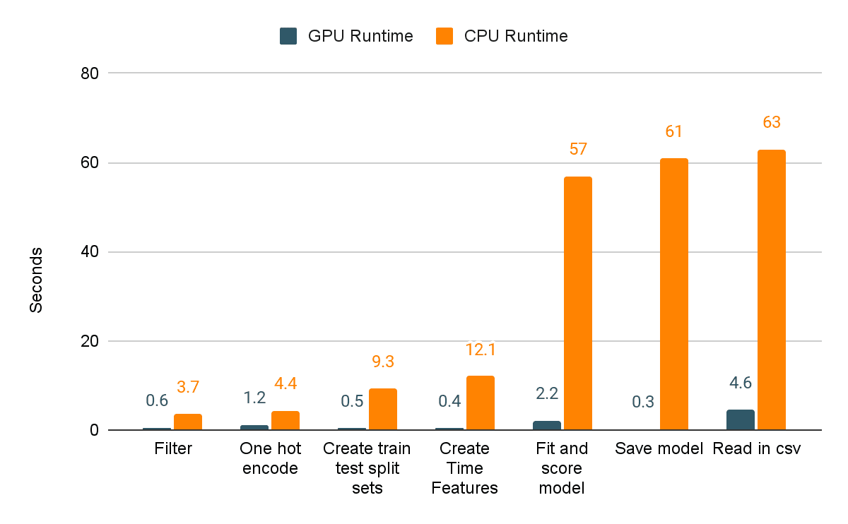
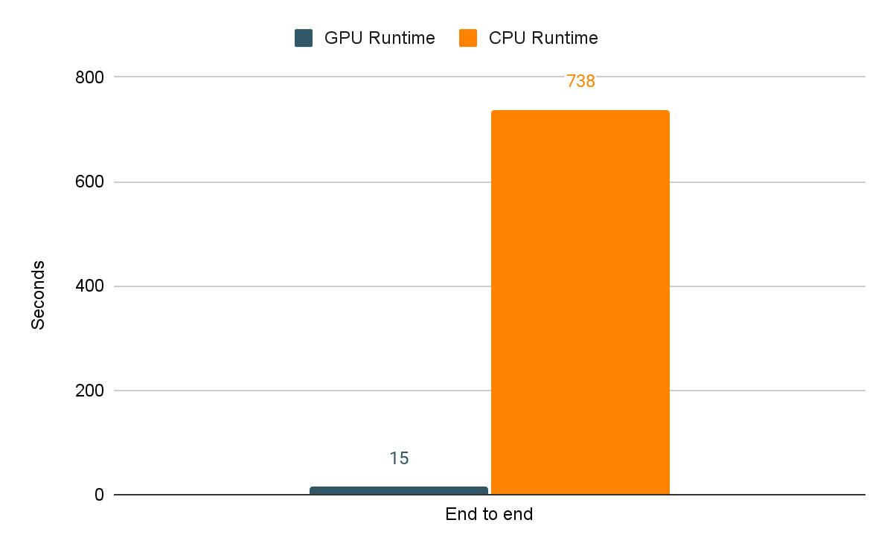
Comparing speeds: trip data for NYC taxis
I came across these on the internet…
Individual Tasks
Entire pipeline
https://blog.cloudera.com/switching-from-cpus-to-gpus-for-nyc-taxi-fare-predictions-with-nvidia-rapids/

Slide 35
Comparing speeds: trip data for NYC taxis
I came across these on the internet…
Individual Tasks
Entire pipeline
…and had to test it out myself….
https://blog.cloudera.com/switching-from-cpus-to-gpus-for-nyc-taxi-fare-predictions-with-nvidia-rapids/

Slide 36
Benchmark: 20M rows & 10 columns
https://github.com/jonathancosme/GPU_vs_CPU

Slide 37
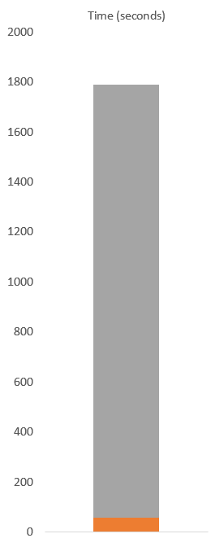
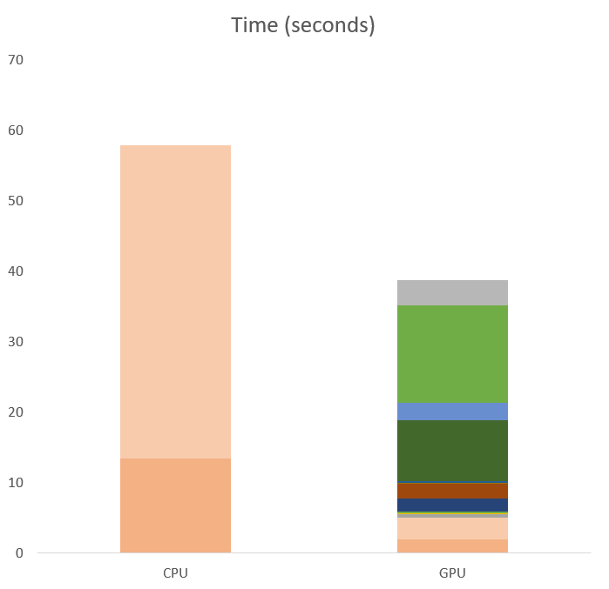
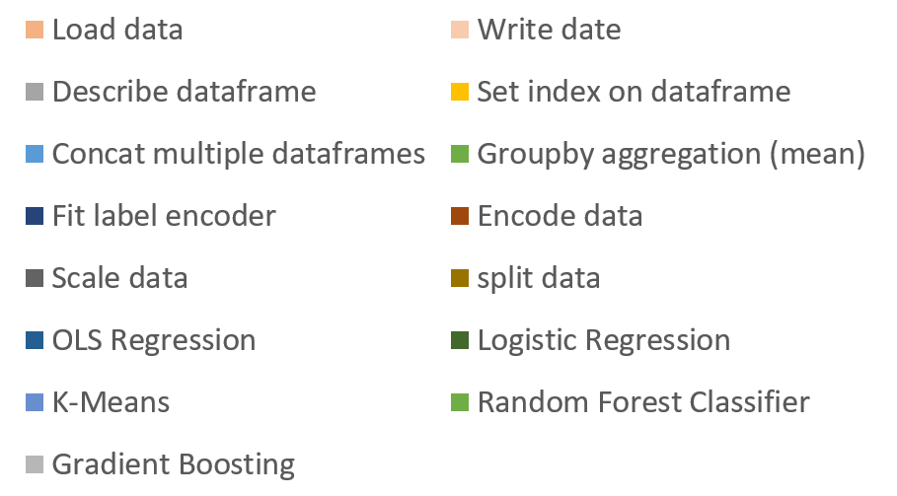
Benchmark: 20M rows & 10 columns
On CPU, in the time that it took to:
CPU
https://github.com/jonathancosme/GPU_vs_CPU

Slide 38
Benchmark: 20M rows & 10 columns
On CPU, in the time that it took to:
The GPU accomplished:
CPU
https://github.com/jonathancosme/GPU_vs_CPU

Slide 39
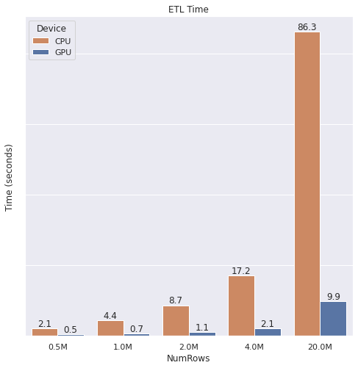
Benchmark: across different file sizes
https://github.com/jonathancosme/GPU_vs_CPU

Slide 40
Benchmark: across different file sizes
For ETL, we see more than 85% reduction in time
https://github.com/jonathancosme/GPU_vs_CPU

Slide 41
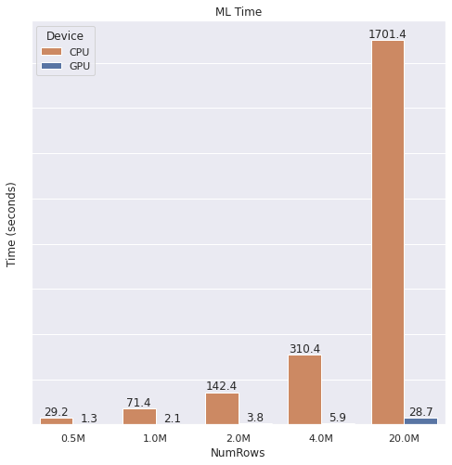
Benchmark: across different file sizes
For ETL, we see more than 85% reduction in time
https://github.com/jonathancosme/GPU_vs_CPU

Slide 42
Benchmark: across different file sizes
For ETL, we see more than 85% reduction in time
For ML, we see a more than 98% reduction in time
https://github.com/jonathancosme/GPU_vs_CPU

Slide 43

Benchmark: across different file sizes
For ETL, we see more than 85% reduction in time
For ML, we see a more than 98% reduction in time
https://github.com/jonathancosme/GPU_vs_CPU

Slide 44
Benchmark: across different file sizes
For ETL, we see more than 85% reduction in time
For ML, we see a more than 98% reduction in time
End-to-end, we see a more than 95% reduction in time
https://github.com/jonathancosme/GPU_vs_CPU

Slide 45
Benchmark: across different file sizes
For ETL, we see more than 85% reduction in time
For ML, we see a more than 98% reduction in time
End-to-end, we see a more than 95% reduction in time
The speed gain are astounding!
https://github.com/jonathancosme/GPU_vs_CPU

Slide 46
Typical GPU day
https://developer.nvidia.com/blog/gpu-accelerated-analytics-rapids/

Slide 47
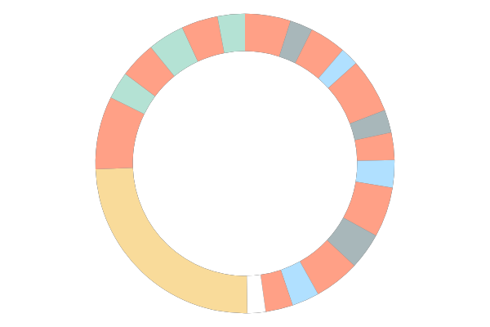
Typical GPU day
Find unexpected null values stored as strings
Restart ETL
Train model
Validate
Eh, forgot to add a feature
Test model
12
Start ETL
workflow
Get a coffee
Experiment with optimizations & repeat
GPU POWERED WORKFLOW
Configure ETL workflow
9
3
dataset collection
Dataset downloads
overnight
6
analysis
ETL
train
inference
Go home on time
https://developer.nvidia.com/blog/gpu-accelerated-analytics-rapids/

Slide 48
Comparing CPU vs GPU day
https://developer.nvidia.com/blog/gpu-accelerated-analytics-rapids/

Slide 49
Comparing CPU vs GPU day
dataset collection
analysis
ETL
train
inference
Another…
@*!# forgot to add a feature
Find unexpected null values stored as strings
Restart ETL
Train model
Get a coffee
Validate
Restart ETL workflow
Eh, forgot to add a feature
Test model
12
12
Start ETL workflow
Get a coffee
Start ETL
workflow
Get a coffee
Experiment with optimizations & repeat
Switch to decaff
CPU POWERED WORKFLOW
GPU POWERED WORKFLOW
Configure ETL workflow
9
3
Configure ETL workflow
9
3
Find unexpected null values stored as strings
Dataset downloads
overnight
Dataset downloads
overnight
6
6
Restart ETL workflow
Stay late
Go home on time
https://developer.nvidia.com/blog/gpu-accelerated-analytics-rapids/

Slide 50
Speed gains with run.ai
Using run.ai’s state-of-the-art scheduler and fractional GPU capabilities, speed gains can be pushed to their maximum
ETL
train
inference
(Size not to scale)
Time
CPU
GPU
run.ai

Slide 51
FAQs

Slide 52
FAQs
All of my code is already in Pandas and Scikit-learn. Do I have to convert it all?
A valid concern!
cuDF was specifically build to mirror Pandas.
cuML was specifically build to mirror Scikit-Learn.
In nearly all cases, your Pandas/Scikit-Learn code is the same as the cuDF/cuML code!

Slide 53
FAQs
What if there’s something I must use pandas for?
No problem!
It's easy to convert back and forth between Pandas Dataframes and cuDF Dataframes!
# from cuDF to Pandas
df = df.to_pandas()
# your unique function
df = my_function(df)
# from Pandas to cuDF
df = cudf.from_pandas(df)

Slide 54
FAQs
What if my data is too large for GPU memory?
No problem!
The Rapids ecosystem includes Dask-GPU, which is designed to handle extremely large datasets, in a distributed way.
Best of all, Dask was originally designed to be a distributed extension of Pandas, so implementing it will be very easy if you are used to pandas!
If you are used to using Spark, Apache has also incorporated the Rapids.ai engine to leverage GPU for ETL pipelines.

Slide 55
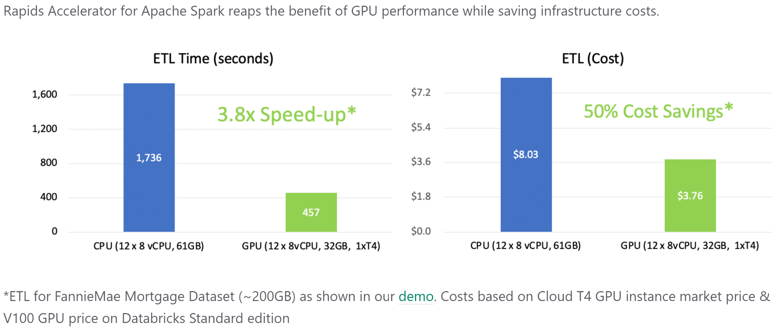
FAQs
GPU instances are expensive. Wouldn't it be cheaper to run a large CPU cluster rather than a GPU?
Actually, because a GPU can process data so much more quickly, the net cost of running a workflow on a GPU vs a large CPU cluster is actually less!
https://nvidia.github.io/spark-rapids/

Slide 56
Use GPUs!

